Slide 1
Analysis of Big Mountain Resort Pricing and Investment Strategy
Matthew Bibee

Slide 2
Problem Statement
BMR is reevaluating its pricing and investment strategy for the upcoming ski season. It has recently installed an additional chair lift at an additional operating cost of $1.5M for the season. It would like to know what level of ticket pricing its current facilities can support, and if any changes to its facilities could cut costs or increase revenue through support for higher ticket prices.
How can Big Mountain Resort (BMR) increase income by at least $1.5M in the next season through changes in ticket pricing and/or facilities offerings?

Slide 3
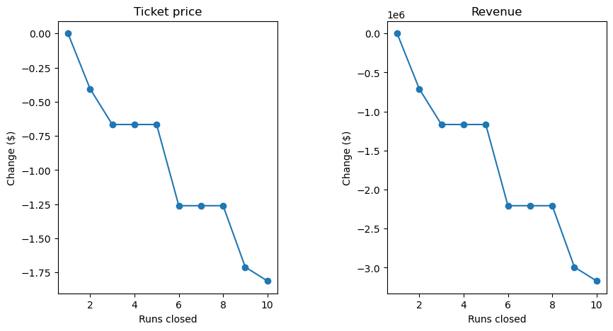
Recommendation and Key Findings
Big Mountain ski resort currently charges $81 for an adult weekend ticket. Based on our best model, the predicted price for Big Mountain is $95.87, with a mean absolute error of $10.39. This suggests an increase in ticket price is supported while maintaining current facilities.
Effect of facility changes:
The addition of 150 feet of vertical drop via an additional lower chair lift would support a ticket price increase of $1.99
Closing runs was found to have a non-linear, step-wise effect on predicted ticket price

Slide 4
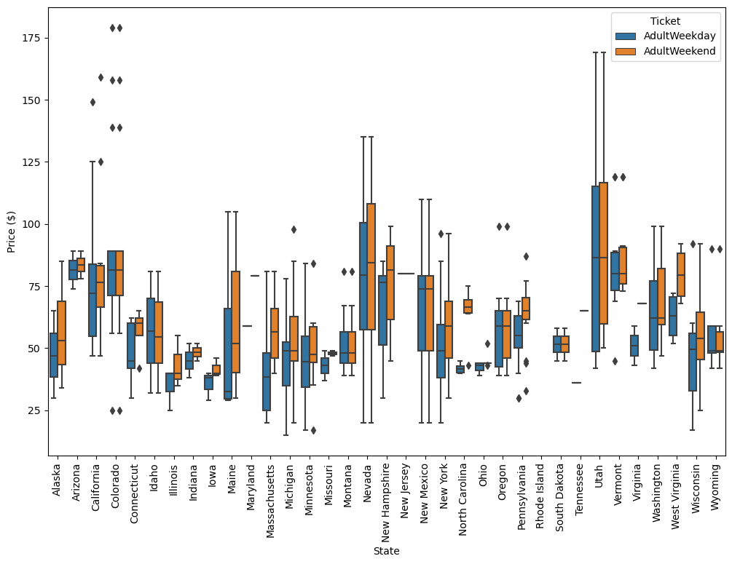
Modelling results
Average ticket price by state

Slide 5
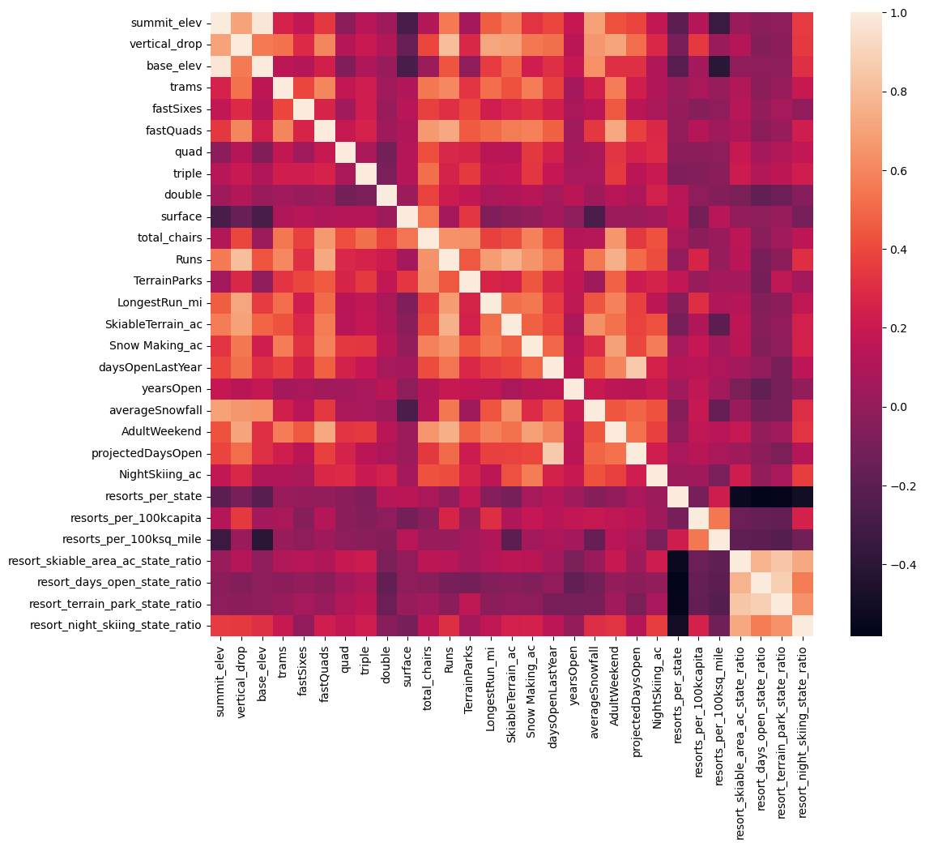
Modelling results
Heat map showing feature correlations

Slide 6
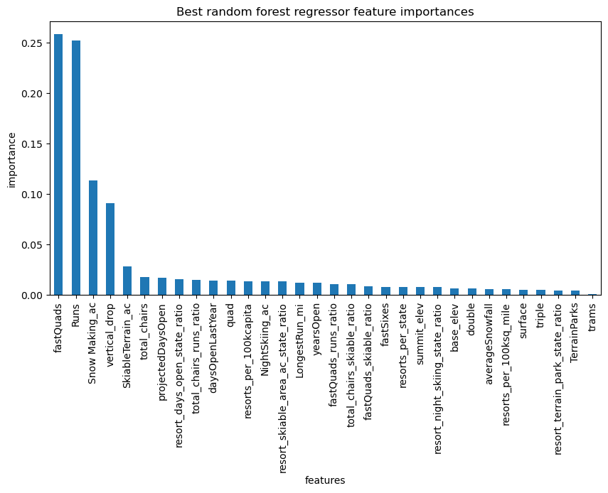
Modelling results

Slide 7
Summary and Conclusions
Big Mountain Resort tickets are currently underpriced relative to the market and facility offerings. An increase in ticket price to $95.87 is supported while maintaining current facilities.
The addition of 150 feet of vertical drop via an additional lower chair lift would support a ticket price increase of $1.99
Closing runs was found to have a non-linear, step-wise effect on predicted ticket price.

